Slide 2
The University of Siegen
Updated: October 2022

Slide 3
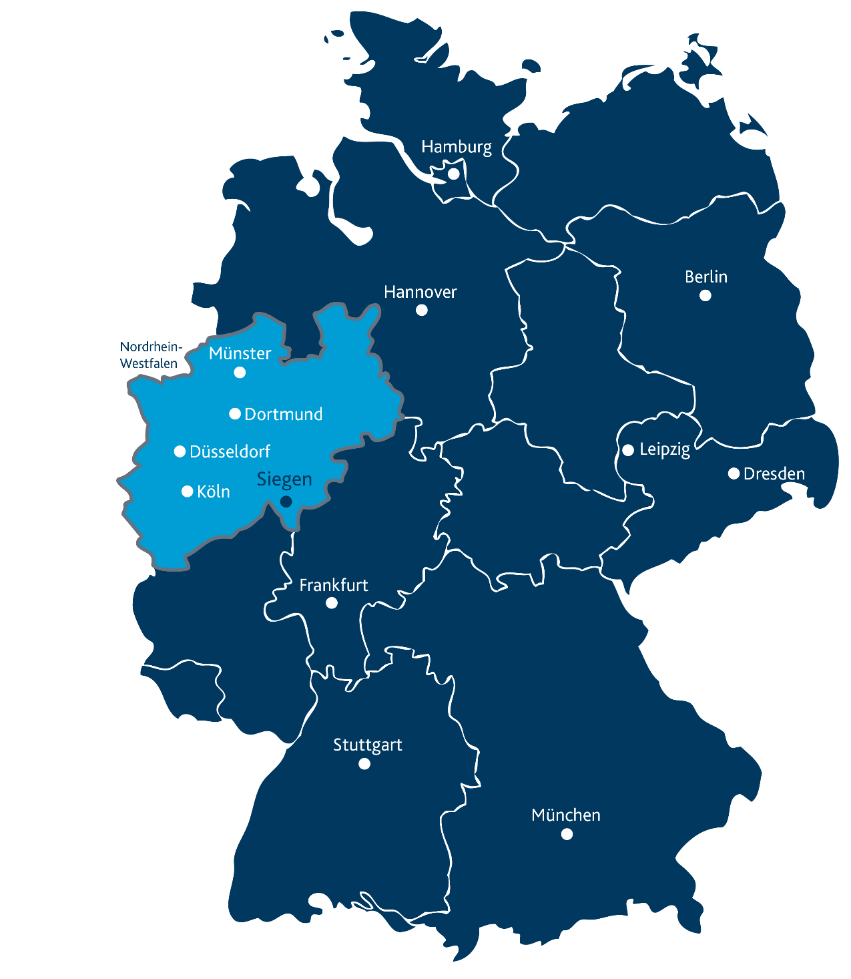
University of Siegen
Location
Siegen

Slide 4
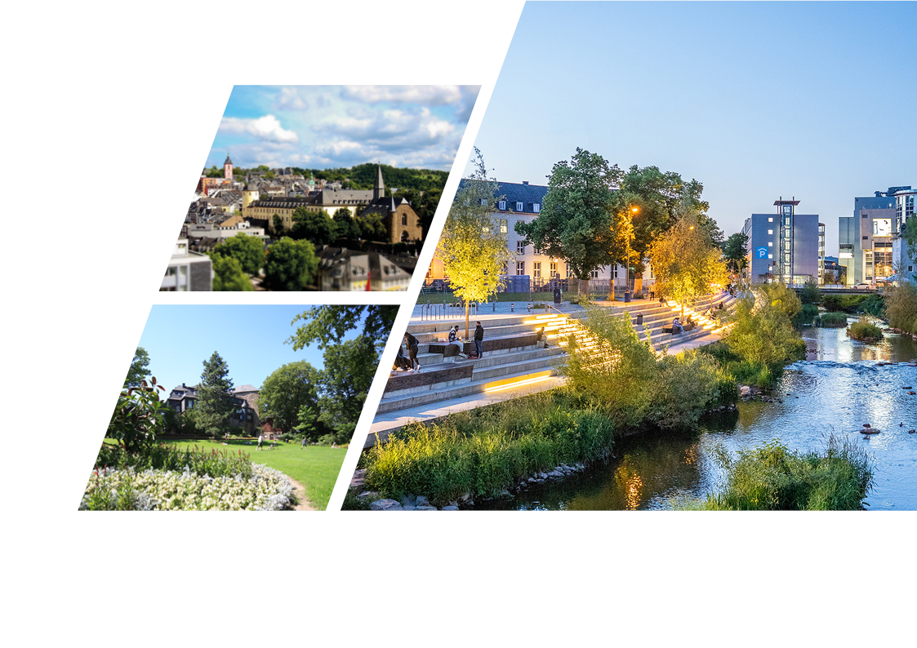
University City of Siegen
Facts and Figures
Area: 114.69 km²
101,943 inhabitants
Current mayor:
Steffen Mues (CDU)
Siegen-Wittgenstein district
Südwestfalen district
Greenest large city in Germany
At the heart of the three-state
junction between North Rhine-Westphalia,
Rhineland-Palatinate and Hesse

Slide 5
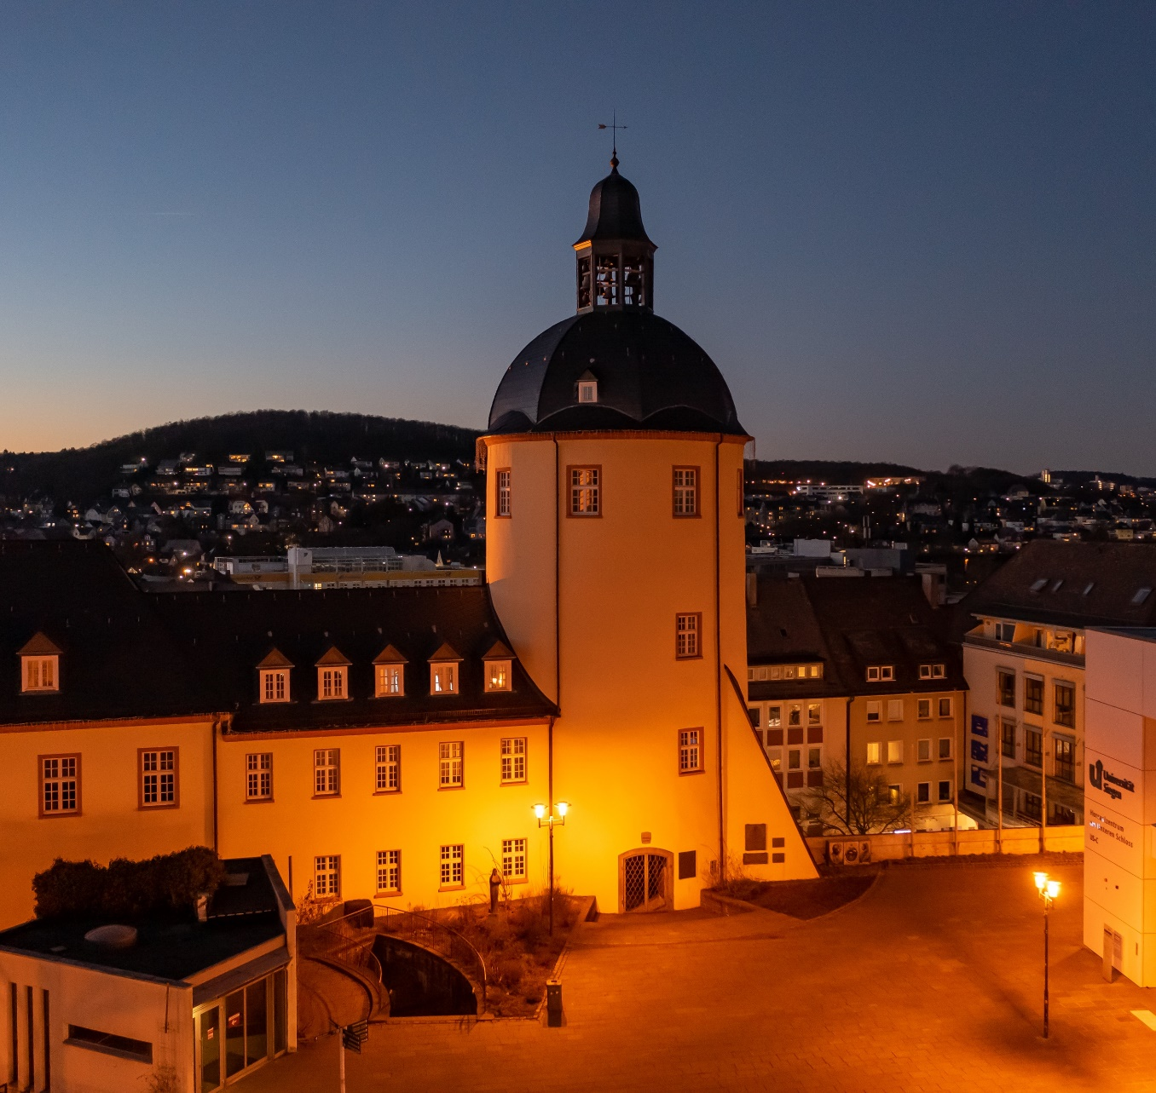
The University of Siegen
Young, modern research university
Strong interdisciplinary orientation in
research and instruction
Excellent mentoring of students
Strong international focus
Mid-sized university of great importance
for the region
Excellent conditions for teachers
and researchers

Slide 6
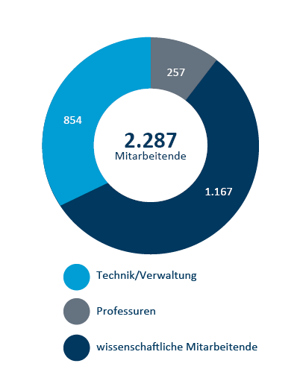
The University in Numbers
Approx. 17,700 students for Winter Semester 2021/22, of those first semester students: 3,495
51 academic degree programs + 1 flexible degree model (School of Arts and Humanities)
9 Teacher Training degree programs,
distributed among 138 degree modules

Slide 7
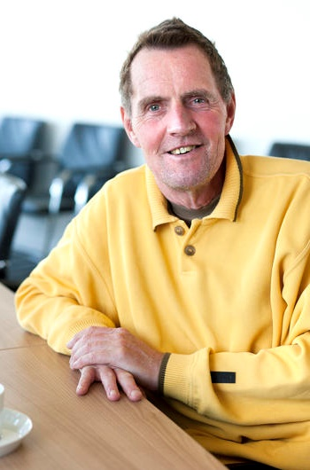
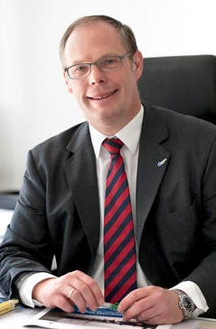
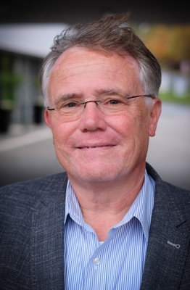
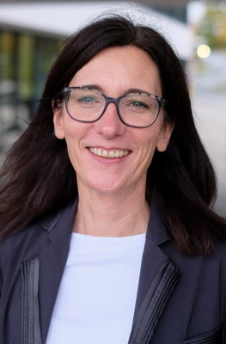
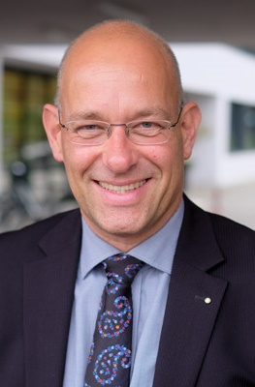
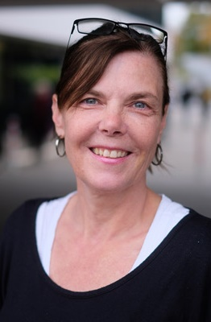
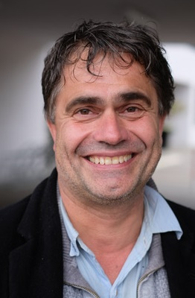
Office of the Rector
Rector
Prof. Dr.
Holger Burckhart
Chancellor
Ulf Richter
Prorector for Research and Junior Scientists
Prof. Dr.
Thomas Mannel
Prorector for Academic Education
Prof. Dr. Alexandra Nonnenmacher
Prorector for Resources and Governance
Prof. Dr.
Volker Stein
Prorector for International Affairs and Lifelong Learning
Prof. Dr.
Petra M. Vogel
Prorector for Digital and Regional Affairs
Prof. Dr.
Volker Wulf

Slide 8





Schools
Faculty I
Faculty of Arts and Humanities
Faculty II
School of Education, Architecture
and the Arts
Faculty III
School of Economic
Disciplines
Faculty IV
School of Science and Technology
Faculty V
School of Life Sciences

Slide 9





University Administration - Divisions
Occupational Health and Safety
Finances
General Procurement and Customs
Division 1: Finances
Division 2: University Development
University Planning and Development
Campus Management
Division 3: Legal and Academic Affairs
Department of Legal Advice and Patents
Academic Affairs and Study-Related Legal Aspects
Human Resource Department and Organization
Department for Professorships
Personnel Matters
Labor Law / Civil Service Law
Division 4: Human Resources and Organization
Construction Matters
Operating Technology
Area and Property Management
Infrastructural Facility Management and Security
Division 5: Area and Property Management

Slide 10
University Administration
Support Offices
i
Registrar's Office
Student Counseling Service
Job Placement Center
Student Admission, Registration and Training in German Language (STARTING)
Student Services Division
International Office
International Student Affairs (ISA)
Welcome Center
Staff Units
Executive Department Financial Controlling
Executive Department Data Protection
Executive Department Digitalization
Executive Department Information Security
Executive Department Internal Audit
Declared a “Quality Audit Science Administration,” reflecting: communicated quality management based on service promises, experienced culture of empowerment, and binding roadmap to digitalization of administrative processes by 2025.

Slide 11

Guiding Principle:
      Promotion of the concept of a European higher education space, of internationality, and of mobility
      Lived culture of quality
      Commitment to diversity and equal opportunity
      Principle of participation and shared responsibility

Slide 12
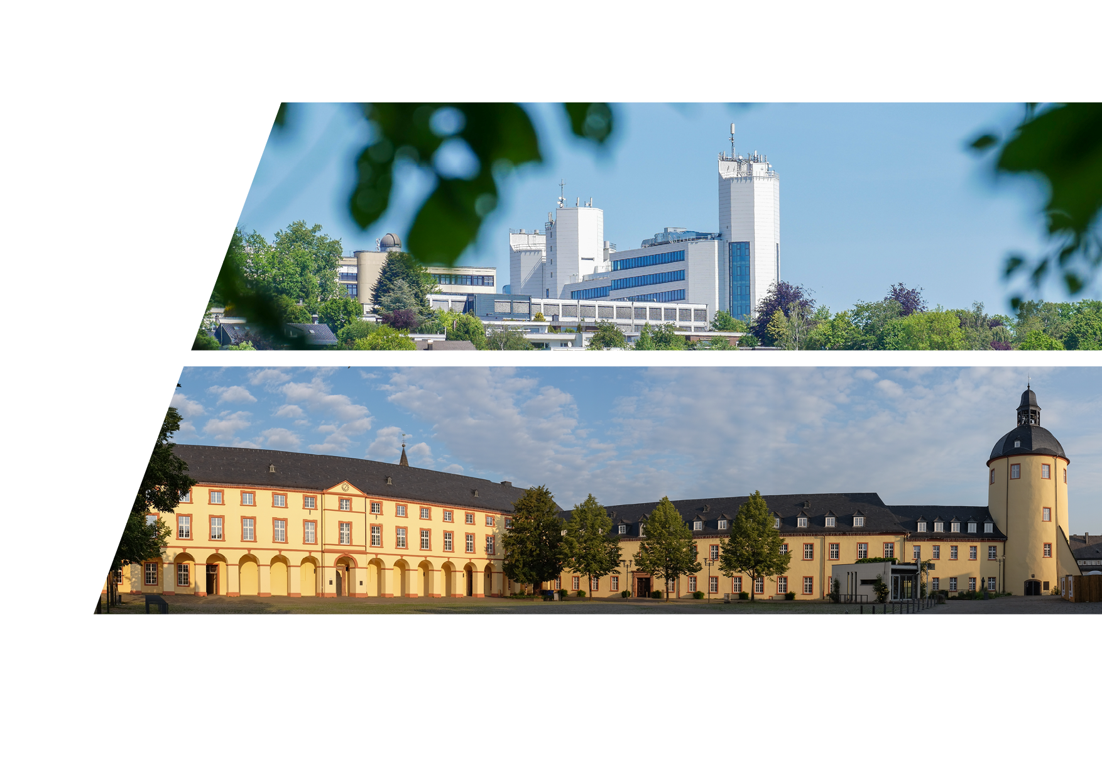
Locations
Two-campus strategy:
Campus Unteres Schloss in the heart of the University City of Siegen
Campus on the Haardter Berg in Siegen-Weidenau (Adolf-Reichwein-Straße, Hölderlin-Straße, Paul-Bonatz-Straße)

Slide 13
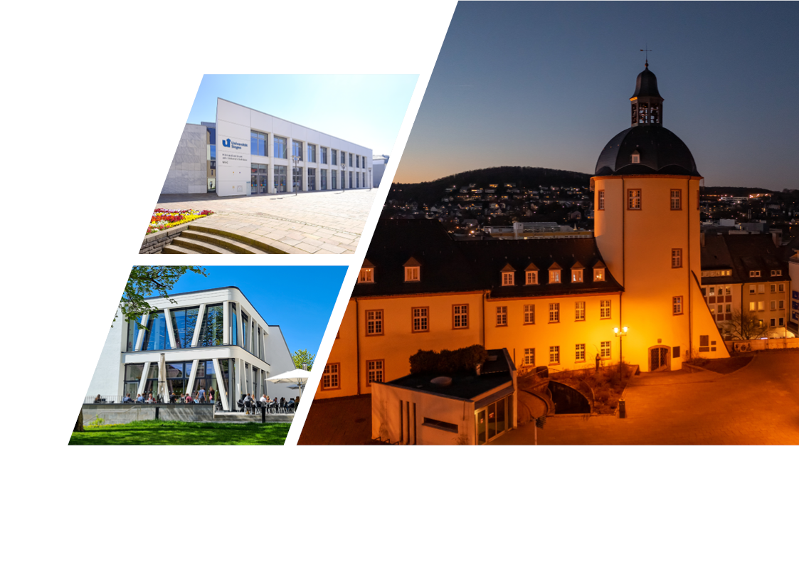
Campus Unteres Schloss
The campus is located downtown,
with some departments in historical buildings, with a dining hall and modern lecture hall cluster.

Slide 14
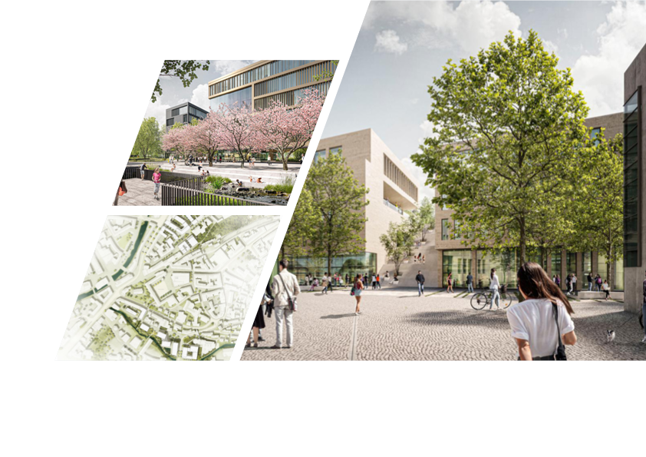
Two further schools are scheduled to move to downtown
Climate-neutral campus locations
Strong added value for the entire city
Contribution to larger societal mobility pivot
Extensive coverage at:
www.siegen-wissen-verbindet.de

Slide 15
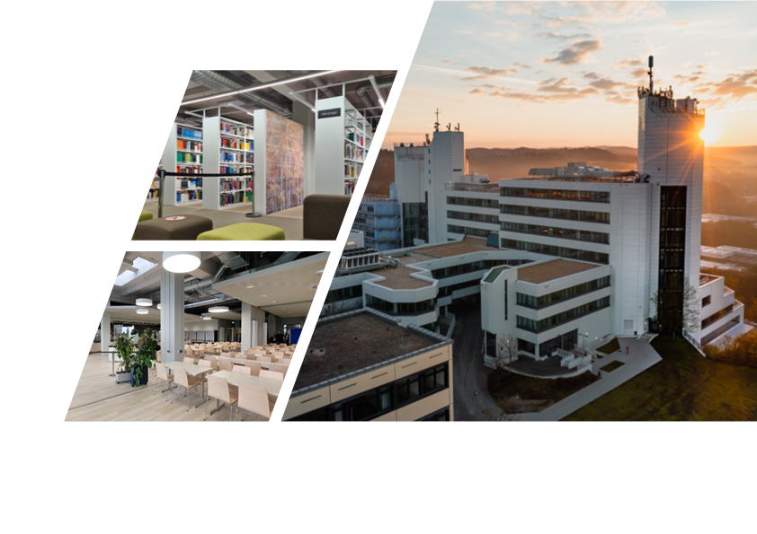
Campus Adolf-Reichwein-Straße
Extensively modernized campus
with renovated university library and
modern dining hall

Slide 16
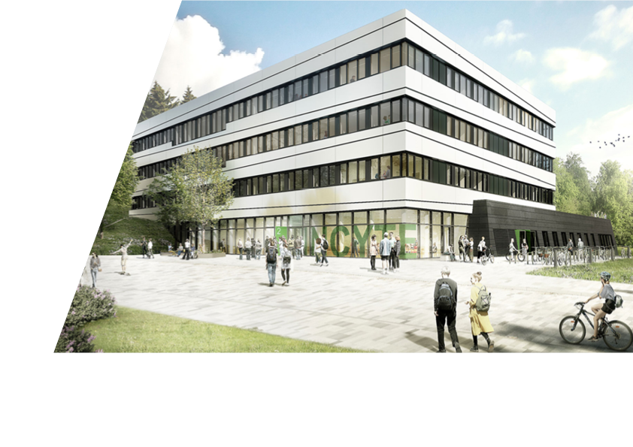
‘INCYTE” Research Center (planned completion 2024)
Modern research center: Interdisciplinary Research Center for Nanoanalytics, Nanochemestry, and Cyber-Physical Sensor Technologies
Roughly 5,200 m² of floor space
Preparation and synthetics labs
Clean room for sensor development
S2 lab

Slide 17
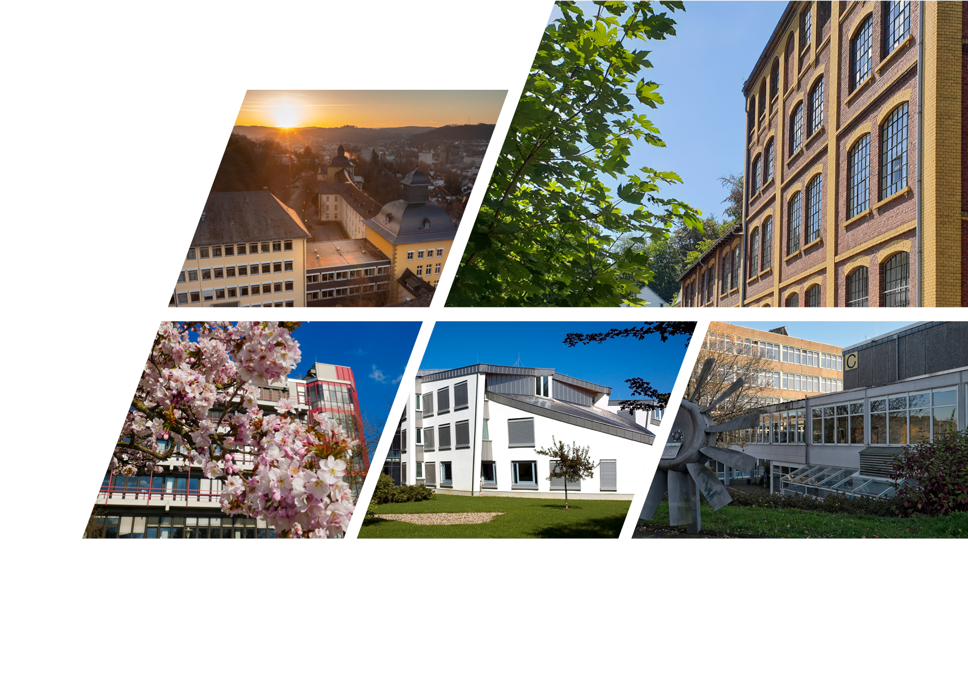
Additional Locations
Emmy Noether-Campus
Brauhaus
Campus Hölderlinstraße
Artur-Woll-Haus
Campus Paul-Bonatz-Straße

Slide 18
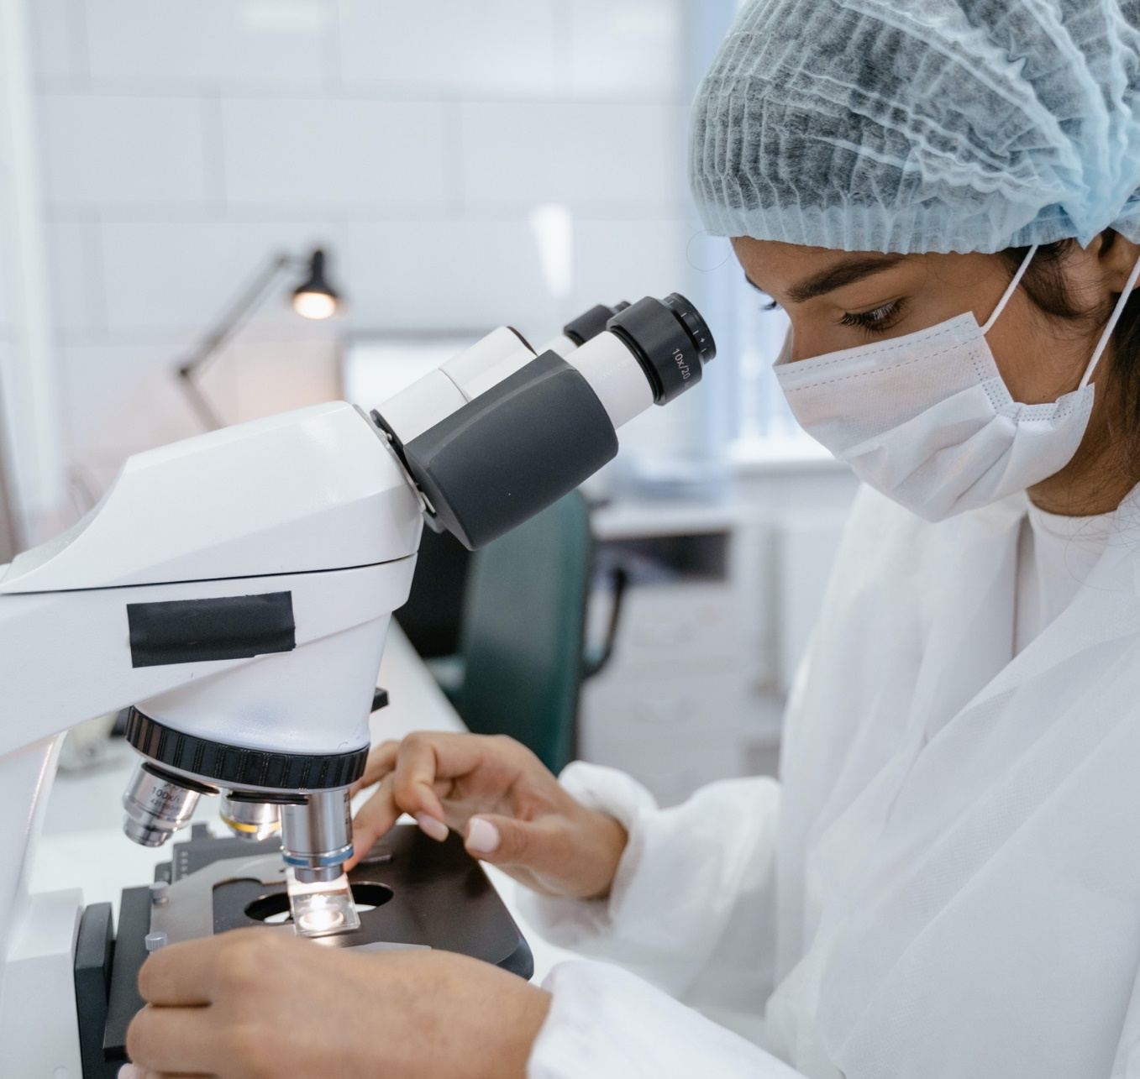
Research
Specializations:
Media and Culture
Education and Social Affairs
Sensors and Visual Computing
Matter and Quantum Systems
Competencies:
Smart Working and Smart Everyday
Nanotechnology and New Materials
Health Care & Gerontology

Slide 19

3 DFG Special Research Areas
Research
    SFB 1473: Transformations of the Popular
    SFB 1187: Media of Cooperation
    SFB/TRR 257: Particle Physics Phenomenology after the Higgs Discovery
    DFG Research Training Group
    2493: Consequences of Social Services Work

Slide 20

Research
    Support for early-career researchers, including
    Graduate Student Center “House of Young Talents”
    Women Career Service
    University-internal young researcher awards
    Mentoring program for women

Slide 21

International Focus
Over 200 partner universities for exchanges
Scholarship funding for Erasmus+ space and overseas
2,427 foreign students from over 100 countries
12 Erasmus+ cooperative projects (KA 2)
European University ATHENA
International Office / Welcome Center

Slide 22

Knowledge Transfer
Transfer of research insights, solutions, and methods in education, business, culture, and society
Acknowledgment that knowledge production is a bi-directional process (research flowing out to the region, and regional experiences flowing back into research)
Mutual reinforcement by science and society on achieving future-oriented changes to the substantial challenges facing society, science, and culture

Slide 23




Knowledge Transfer
Citizens & Region
House of Science
Wednesday Academy
Forum Siegen
Region in Dialog
Kid's university
Open University – Ready to Study
Industry & Business
Automotive Center Südwestfalen
R&D projects
Research Partner Smart Demonstration Factory Siegen
Dual Study Program
Pivot Mounting Technology Center
Bombardier and University of Siegen
Alumni & Founders
connectUS
Entrepreneurship Center
Startpunkt 57

Slide 24
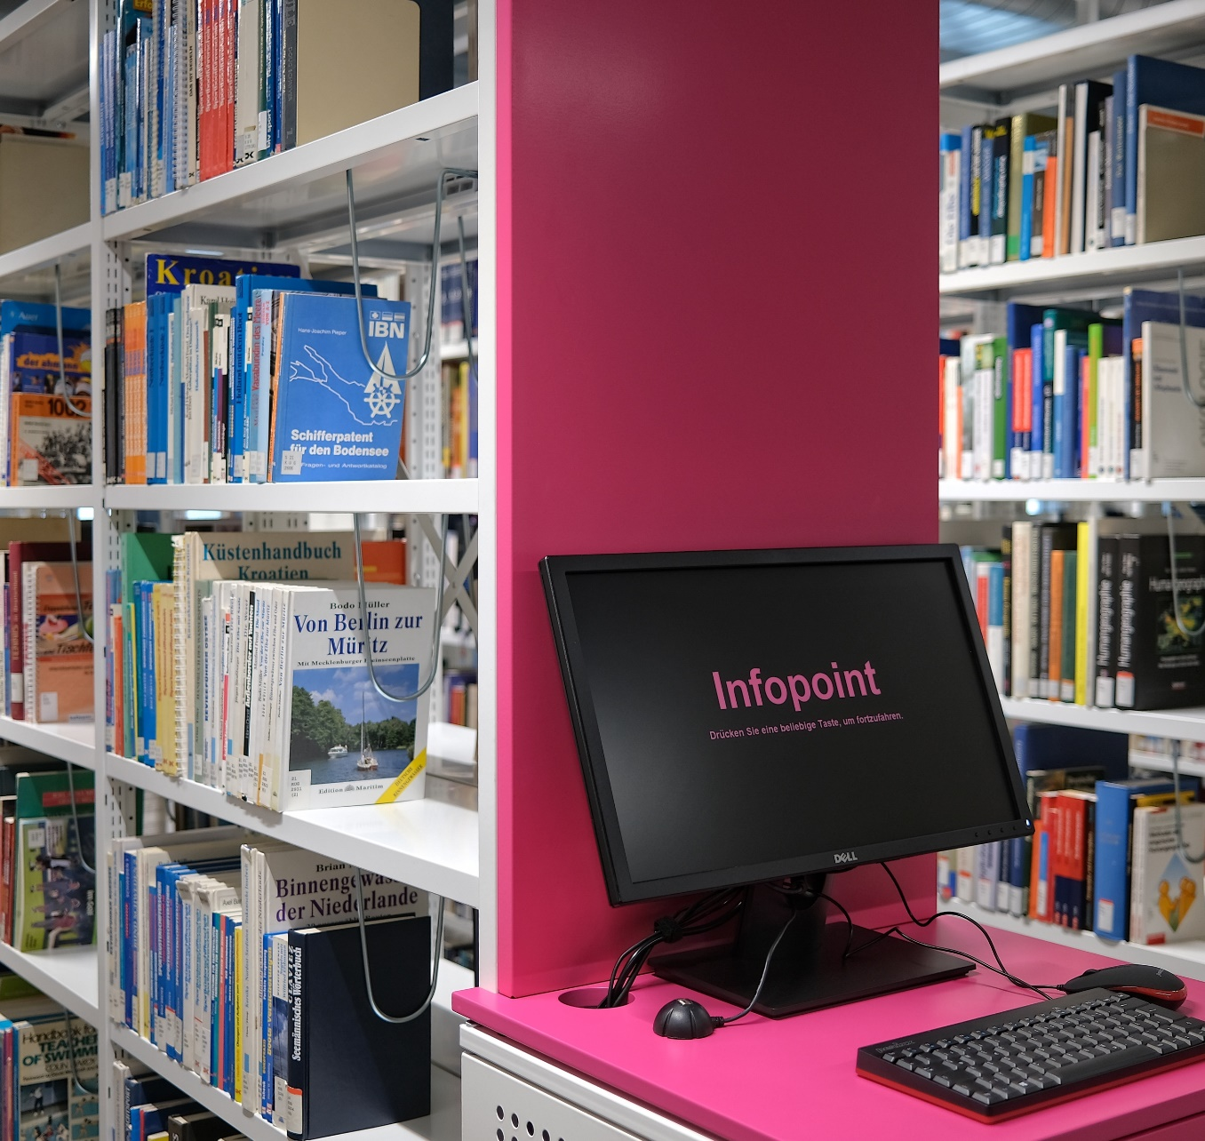
Service Units
University Library
Alumni Association
Career Service
Dual Career Service
Parent and Family Services
Entrepreneurship Center
Gender Studies Siegen (GestuS)
Job placement center
Language Center
Historical name consultation / language consultancy
Center for Information and Media Technology (ZIMT)

Slide 25

Diversity &
Equal Opportunity
Promotion for equal opportunities between men and women
Balance between family and career / studies
Dismantling of hurdles
Consultation and support for employees and students
Promotion of diversity at the university in terms of gender, cultural and
social background, educational background and life circumstances

Slide 26

Sustainability mission
The University of Siegen
Pursues sustainability in research
Anchors sustainability in its instruction
Reinforces its own sustainable actions and
the sustainability of its infrastructures
Transfers the sustainability considerations toits regional surroundings, taking account for their specific sensibilities

Slide 27








Certificates

Slide 28

Studying at the
University of Siegen
Bachelors / Masters degree programs
Doctoral studies
International degree programs
Additional qualifications for students
All information can be found at:
www.studieren-siegen.de

Slide 29
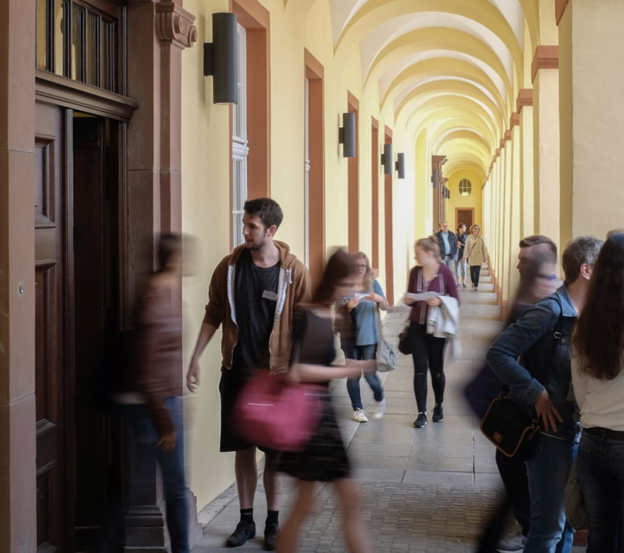
Studying at the
University of Siegen
Online application and registration via online portal unisono
Informational offerings on degree programs / financing of studies and support through Student Counseling Service

Slide 30
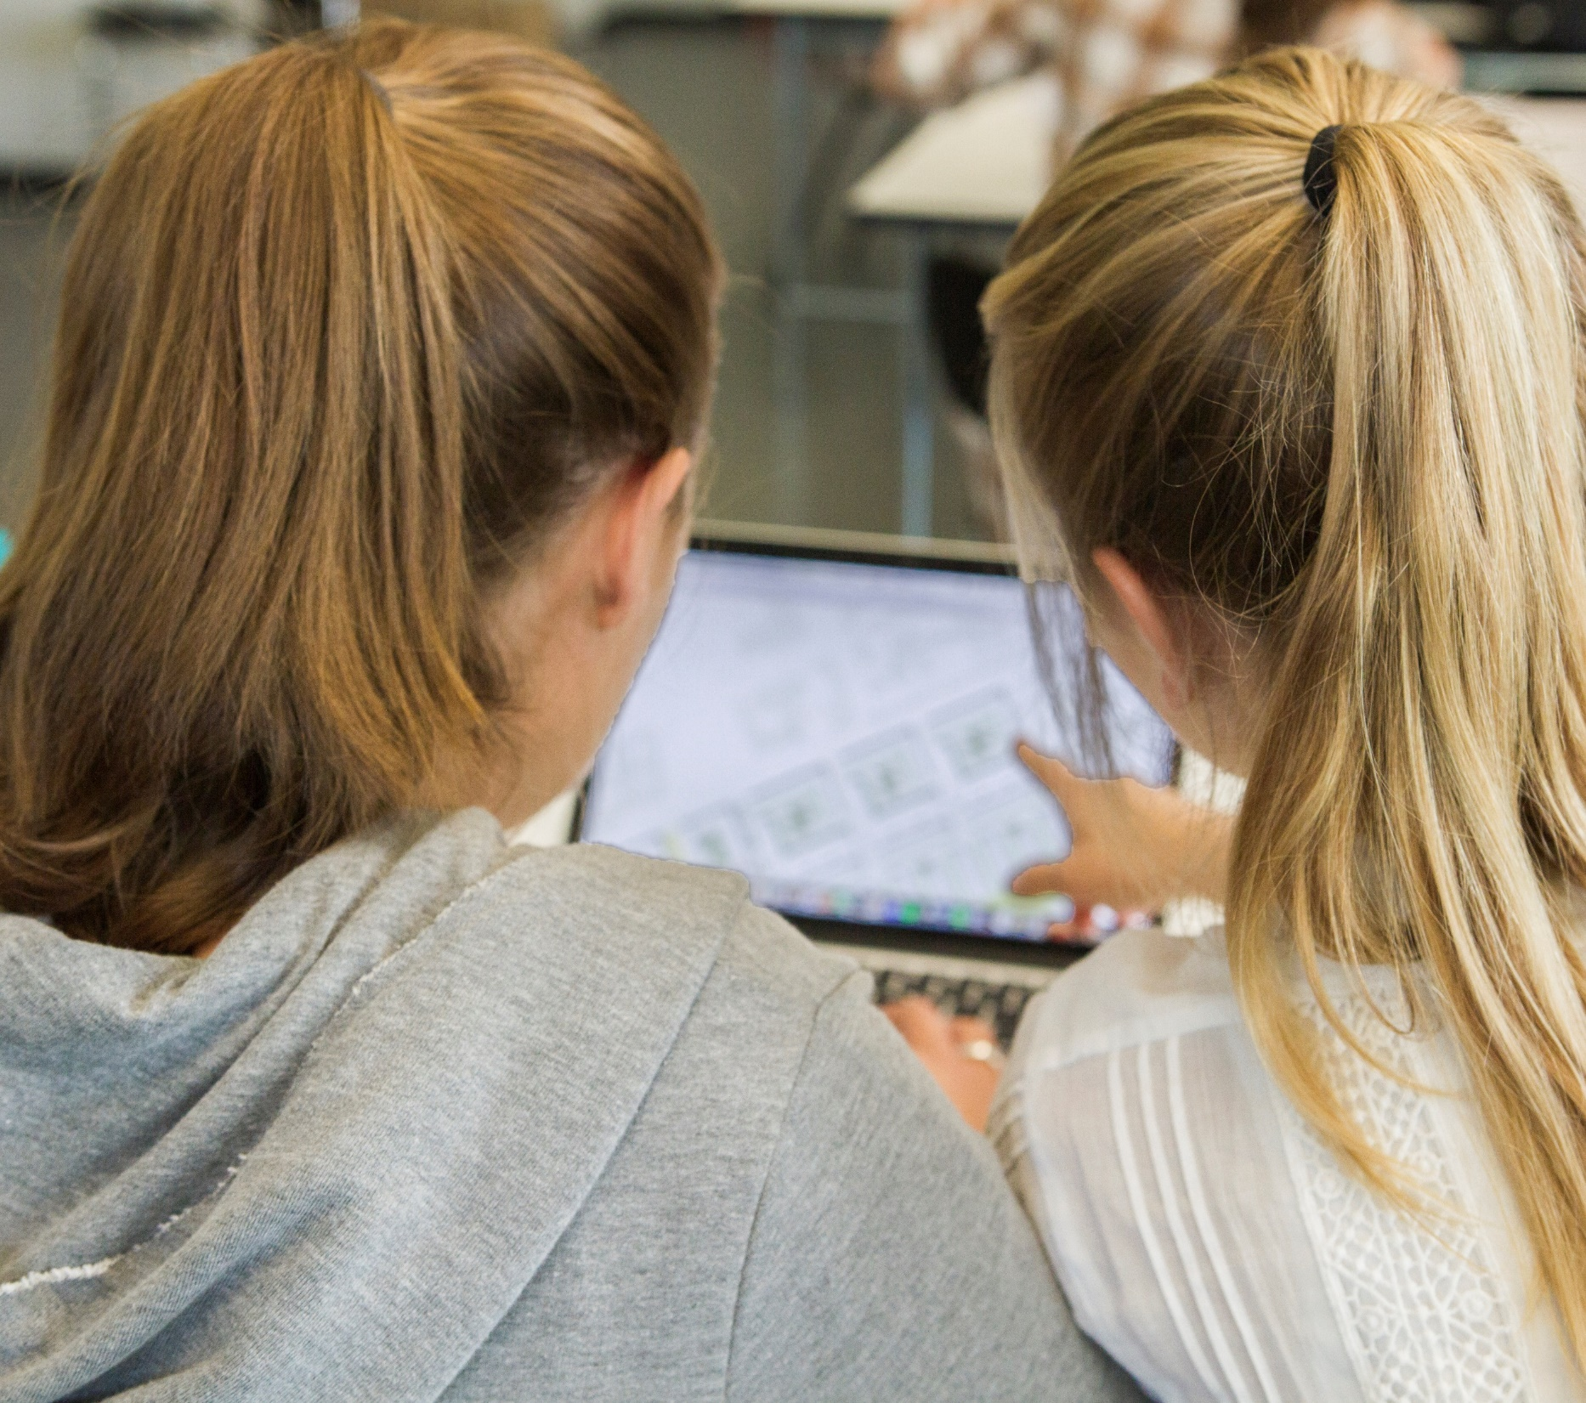
Offerings for
Secondary school students
University internship
Student for one day
Kid's university
High school student lab
New student orientation weeks
Bridge to Studying (BisS)
Attending trial lectures
Girls‘ Day / Boys‘ Day etc.

Slide 31
Thank you!
All information also provided at:
    https://www.uni-siegen.de/

